Slide 1
Web Search Engine
Group Member:
Xiongjin Yue
Yihao Yang
Kuo Han
Ruoqi Shan

Slide 2
Part 1
Xiongjin Yue

Slide 3
Features-WebSearch
Crawling HTML
Build http connection
Parse the URLs on that page and get the document objects
Download html files to local
01
02
Convert HTML files to text files
Parse HTML files and find the txt content
Create new txt files
03
Search certain strings in text files
Locate the string
Return the content of the line where the string is located

Slide 4
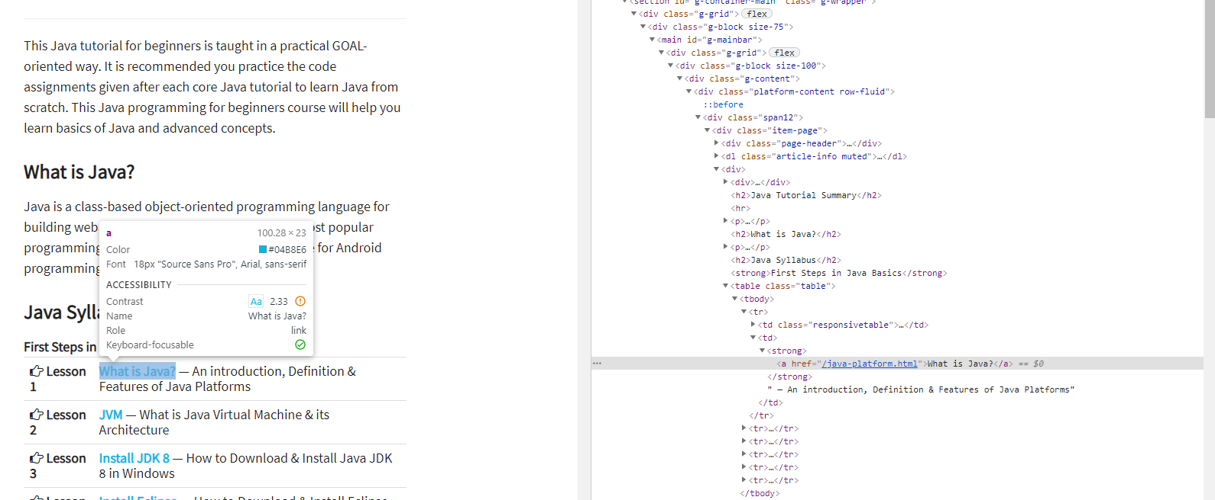
Crawler
We have many PowerPoint templates that has been specifically designed to help anyone that is stepping into the world of PowerPoint for the very first time. We have many PowerPoint templates that has been specifically designed to help anyone that is stepping into the world of PowerPoint for the very first time.
OPTION 01
We have many PowerPoint templates that has been specifically designed.
OPTION 02
We have many PowerPoint templates that has been specifically designed.
OPTION 03
We have many PowerPoint templates that has been specifically designed.
OPTION 04
We have many PowerPoint templates that has been specifically designed.

Slide 5
Part 2
Yihao Yang

Slide 6
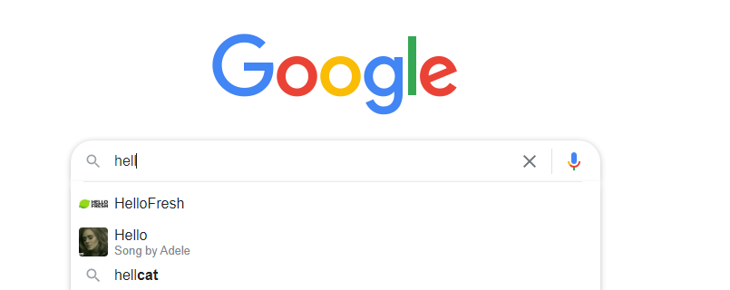
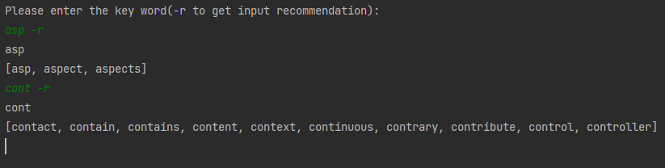
Input Recommendation

Slide 7
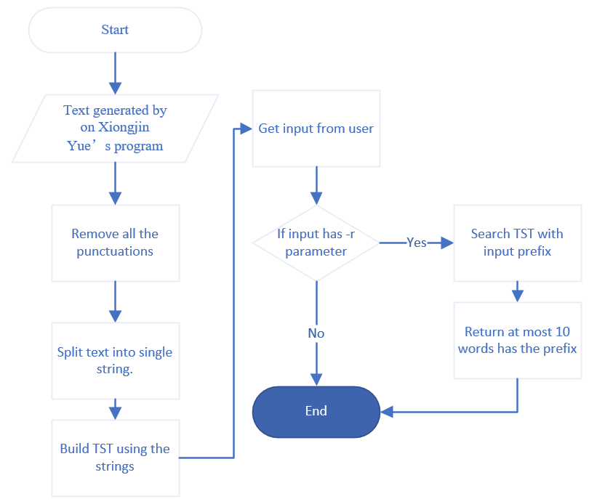
Input Recommendation
Based on the TST algorithm
Maintaining a TST structure
Using text generated by Xiongjin Yue's program
Searching prefix in the TST and return at most 10 words has the prefix

Slide 8
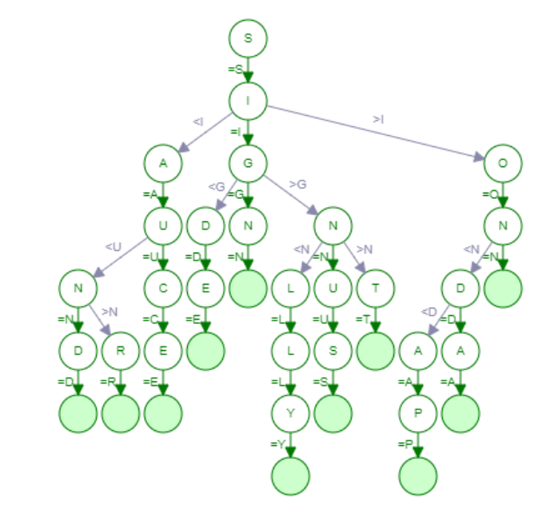
Input Recommendation
For processing N Strings with average w length:
If search doesn’t hit, the time complexity is O(1.39lgN);
Space usage is 64N – 64Nw.^{[1]}
TST diagram^{[2]}

Slide 9
Part 3
Kuo Han

Slide 10
Main functions of the software
Count the words in a file and the number of times each word appears
File Type: HTML files, TXT files or even Web pages.
Create a Dictionary & a Map
Output all the words in the file, and the 10 most frequent words.
Check the existence of words and their frequency

Slide 11
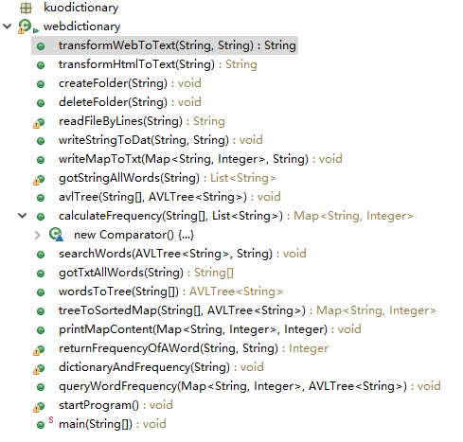
Functions included in my program
Fig.1 Functions

Slide 12
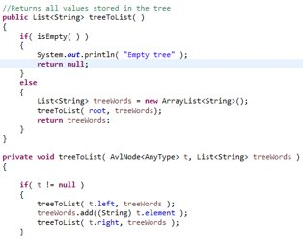
Classroom knowledge points used
Jsoup
transformWebToText(String, String)
transformHtmlToText(String)
StringTokenizer
Java Regex
gotStringAllWords(String string)
Map
treeToSortedMap(String, AVLTree<String>)
printMapContent(Map<String, Integer>, Integer)
AVLTree
avlTree(String[], AVLTree<String>)
searchWords(AVLTree<String>,String)
Fig.2 new functions in AVLTree.java

Slide 13
Part 4
Ruoqi Shan

Slide 14
Search
A single word
Sorted by occurrences
Show URLs by decreasing order
Show brief contents that contain the word
Several words
Search for number of all words
Search for number - 1 of all words
Search for number - 2 of all words
.
.
.
Search for one single word from all words
Sorted by occurrences
Show URLs and brief contents by decreasing order
Use process
Enter words/word
Hit enter - Show 10 or less webs first
Hit enter - Show 10 more webs - loop
If there are less than 10 webs, show all remaining webs

Slide 15
Search
Search several words
String matching
Regular expression
Search a single word
Kuo Han’s dictionary
Rank webs
dual-pivot Quicksort
Store and Get data
HashMap and Tree

Slide 16
References
R. Sedgewick, K. Wayne, Algorithms 4th edition, Beijing: Post and Telecom press (In Chinese), 2012.
H. B. Mishra, Autocomplete Feature using Ternary Search Tree. https://iq.opengenus.org/autocomplete-with-ternary-search-tree/

